Slide 1
Variables and data
A Lecture for the c++ Course
Each slide has its own narration in an audio file. For the explanation of any slide, click on the audio icon to start the narration.
The Professor‘s C++Course by Linda W. Friedman is licensed under a Creative Commons Attribution-NonCommercial-ShareAlike 3.0 Unported License.

Slide 2
Compute the mean of 3 numbers
This program here produces the output below.
//mean1.cpp
// This program calculates the mean of three numbers.
#include <iostream>
using namespace std; //need this to drop std::
int main()
{
cout << "First Arithmetic Program by Big Bird.\n\n";
cout << (12+5+10)/3;
return 0;
} //end main

Slide 3
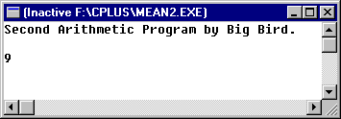
Compute the mean of 3 numbers
Now, let’s try using a variable to store the mean before printing it.
//mean2.cpp
// This program calculates the mean of three numbers.
// Big Bird learns about variables.
#include <iostream>
using namespace std;
int main()
{
float mean;
cout << "Second Arithmetic Program by Big Bird.\n\n";
mean = (12+5+10)/3;
cout << mean;
return 0;
} //end main

Slide 4
Stored Data
Variables (objects) must be declared as a certain type, e.g., int, float, char, … This declaration may appear anywhere in the program, as long as it appears before the variable is first used. The declaration creates the object.
For the following declaration,
int n;
The name of the object is n, the type (or class) is int. The object does not yet have a value.
n = 66; //now it has a value
or
int n=66; //This declaration also gives a value to n

Slide 5
Stored Data
A Variable (object) has:
A name
A location in main memory. This is an address in primary memory where the value of the object is stored while the program is executing.
A type (class). A class defines the way the data item looks (e.g., char or int), how much space it takes up in memory, and how it operates.
A value. It may have a value stored in the named location. There are 3 ways to give a variable a value:
Give it an initial value at the declaration: int n=66;
Assign it a value using the assignment (=) operator: n=66;
Read the value in from an input device such as the keyboard: cin >> n;

Slide 6
Names (Identifiers)
Variables and other program elements will have to have names. Names should be meaningful to help document your program.
may use letters, digits, underscores. No spaces.
may not begin with a digit
may be any length but better if less than 31 characters long.
C++ is case sensitive; upper and lower case letters are different.
no reserved words (e.g., const, void, int, …).
Avoid using names beginning with _ (underscore) or _ _ (double underscore). The C++ compiler uses names like that for special purposes.

Slide 7
Compute the mean of 3 numbers (again)
//mean3.cpp
// This program calculates the mean of three numbers.
// Big Bird tries new data.
#include <iostream>
using namespace std;
int main()
{
float mean;
cout << "Third Arithmetic Program by Big Bird.\n\n";
mean = (11+5+10)/3;
cout << mean;
return 0;
} //end main
OOPS!! What happened?

Slide 8
Types of errors in our programs
Syntax errors – compile-time errors
These errors are picked up by the compiler and we will usually get error messages about them. Syntax errors result from using the language incorrectly.
Logic errors – run-time errors
These errors are generally not flagged by the system. We find out about them by checking the output to see whether it is correct.

Slide 9
Compute the mean of 3 numbers
This is better:
//mean4.cpp
// This program calculates the mean of three numbers.
// Big Bird learns that expressions have a type.
#include <iostream>
using namespace std;
int main()
{
float mean;
cout << "Fourth Arithmetic Program by Big Bird.\n\n";
mean = (11+5+10)/3.0;
cout << mean;
return 0;
} //end main

Slide 10
Compute the mean of 3 numbers
NOW we have a working program that correctly gives us the mean of 11 and 5 and 10…. WOW!!
[Uh… How useful is this?]
What if we want to be able to calculate the mean of ANY three numbers? We need to input data to the program.

Slide 11
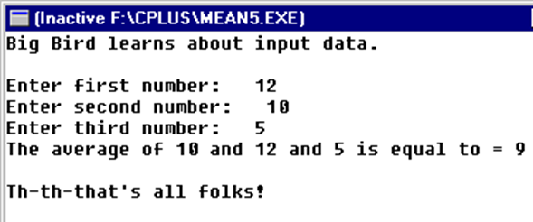
Compute the mean of any 3 numbers
//mean5.cpp
// This program calculates the mean of ANY three numbers.
// Big Bird learns about input data.
#include <iostream>
using namespace std;
int main()
{
float num1, num2, num3, mean;
cout << "Big Bird learns about input data.\n";
cout << endl;
cout << "Enter first number: ";
//prompt user for input
cin >> num1;
cout << "Enter second number: ";
cin >> num2;
cout << "Enter third number: ";
cin >> num3;
mean = (num1+num2+num3)/3.0;
cout << "The average of " << num1 << " and " << num2 <<
" and " << num3;
cout << " is equal to = " << mean << endl <<endl;
cout << "Th-th-that's all folks!\n";
return 0;
} //end main

Slide 12
Stream Input / Output
cout << //means “cout gets a value”
cin >> var //means “cin gives a value to var”
//note: on execution press enter key to end input
>> is the stream extraction operator
<< is the stream insertion operator
The stream insertion operator “knows” how to output different types of data.
Cascading stream insertion operators - using multiple stream insertion operators in a single statement. Also known as concatenating or chaining, e.g.,
cout << “The answer is: ” << result << ".\n";

Slide 13
Review
What did we learn in this lecture? Plenty. Some terms to jog your memories:
assignment operation
cascading stream insertion operators
class
compile-time error
data type
declaring a variable
logic error
object
run-time error
stream extraction operator
stream insertion operator
syntax
syntax error
variable

